Slide 1
16-bit Carry-Lookahead Adder
EEE 468 –VLSI Circuit and Design Laboratory
Level-4 Term-2
Final Project Presentation
Submitted by – G2 Group 03
07 December 2024
Supervisors:
Nafis Sadik
Lecturer,
Dept. of Electrical and Electronic Engineering
BUET, Dhaka
Rafid Hassan Palash
Lecturer(PT),
Dept. of Electrical and Electronic Engineering
BUET, Dhaka

Slide 2
Outline
Summary
PnR with DRC and LVS
Introduction
Directed Testbench
Layered Testbench
Design RTL
Synthesis
Optimization
Final Parameter
Acknowledgement and References
Presented by: 1906081

Slide 3
Outline
Summary
PnR with DRC and LVS
Introduction
Directed Testbench
Layered Testbench
Design RTL
Synthesis
Optimization
Final Parameter
Acknowledgement and References
Presented by: 1906081

Slide 4
16-bit Carry-Lookahead Adder
Designed an optimized 16 Bit Carry Lookahead Adder
RTL Design
Directed
Testbench
Layered
Testbench
Synthesis
PnR with
DRC and LVS
Presented by: 1906081

Slide 5
Outline
Summary
PnR with DRC and LVS
Introduction
Directed Testbench
Layered Testbench
Design RTL
Synthesis
Optimization
Final Parameter
Acknowledgement and References
Presented by: 1906081

Slide 6
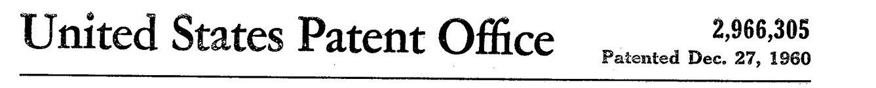
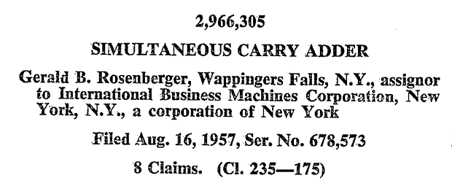
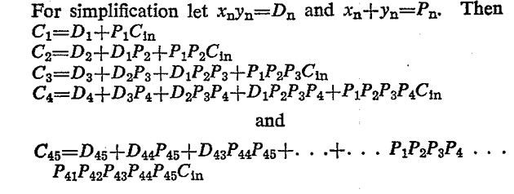
Introduction
[1] G. B. Rosenberger, “Simultaneous Carry Adder,” Dec. 27, 1960 Accessed: Dec. 06, 2024. [Online]. Available: https://patents.google.com/patent/US2966305
Presented by: 1906081

Slide 7
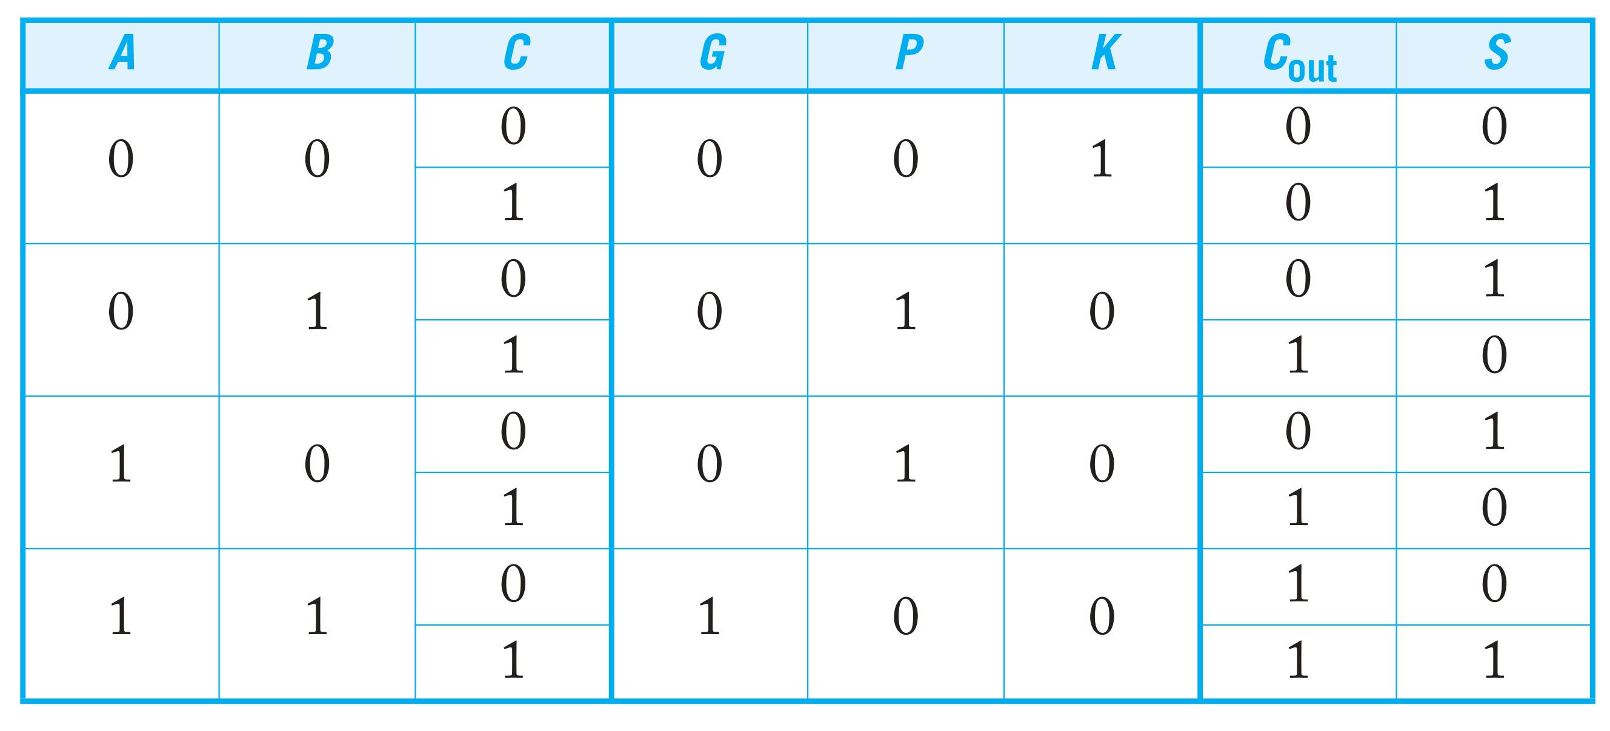
Introduction
[2] N. H. E. Weste and David Money Harris, CMOS VLSI design : a circuits and systems perspective. Noida: Pearson, 2015.
Presented by: 1906081

Slide 8
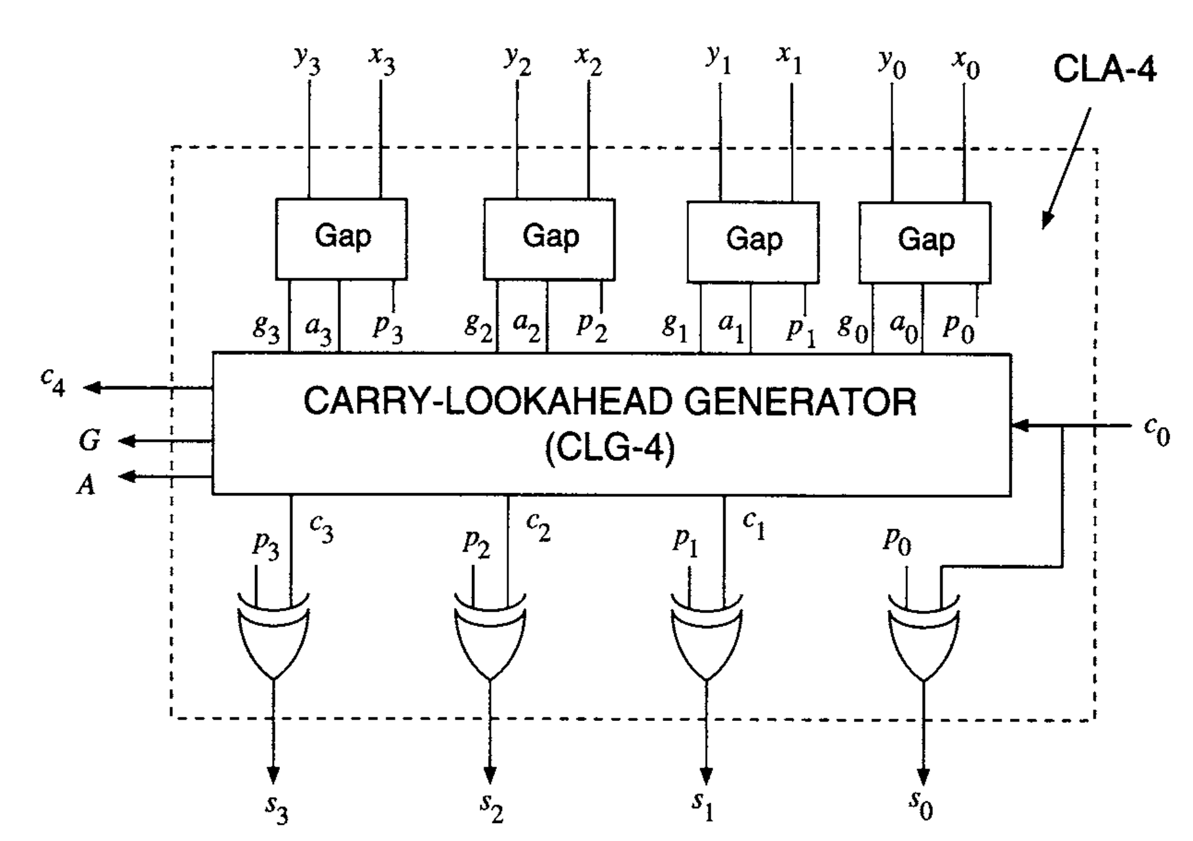
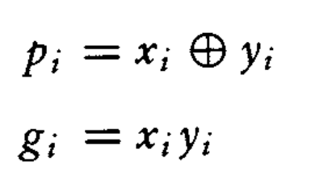

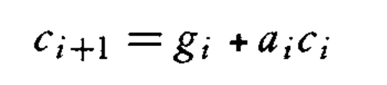
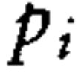
Introduction
[3] ErcegovacM. D. and LangT., Digital arithmetic. San Francisco, Ca: Morgan Kaufmann Publishers, 2004.
Presented by: 1906081

Slide 9
Outline
Summary
PnR with DRC and LVS
Introduction
Directed Testbench
Layered Testbench
Design RTL
Synthesis
Optimization
Final Parameter
Acknowledgement and References
Presented by: 1906081

Slide 10
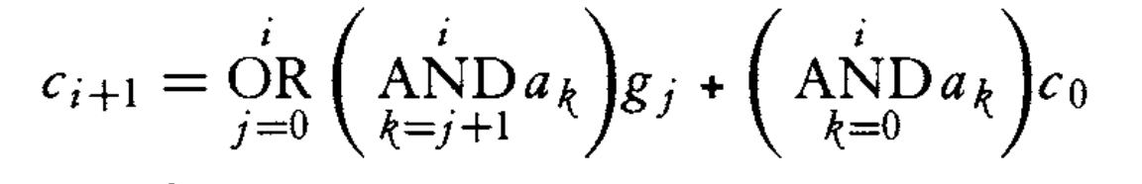
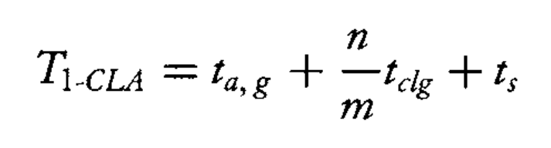
RTL Design
Optimization-1:
Presented by: 1906081
Notes:
we can see the carry equation becomes very complex as the number of bits increases. For bit position 15, we would need:
One 16-input OR gate
15 AND gates with input sizes ranging from 2 to 16 This makes the implementation impractical due to large fan-in requirements.
9+
include "alu_parameters_pkg.sv" import alu_parameters_pkg::*; // Interface definition interface alu_if(input clk); logic [INPUT_WIDTH -1 : 0] a,b; //8bit input logic [OP_WIDTH - 1 : 0]
pasted
S
I'll help you modify the testbench for the carry-lookahead adder (CLA) interface while maintaining the same verification structure. Let me create a modified version that handles the CLA's inputs and outputs.
CLA Testbench
Click to open code
The main changes I made to adapt the testbench for the CLA include:
Modified the interface to include CLA-specific signals (a[15:0], b[15:0], cin, sum[15:0], carry_out16)
Updated the transaction class to match CLA signals
Removed all selector-related logic from the scoreboard
Added carry_out16 checking in addition to sum verification
Modified the coverage tracking to focus on CLA-specific metrics
Updated the file operations to use CLA-appropriate naming
Simplified the scoreboard's result checking since there's only one operation (addition)
Modified the monitor to capture both sum and carry_out16
Would you like me to modify any specific part of this testbench further?
CopyRetry
S
The code I have given you tests also for 3D coverage which is s cross a cross b, similarly find out the same thing for the c cross a cross b, also the code I have given you can itself increase the count and keep running the program with non-linear step values in the environment class. Include these things for the cla code
Edit
I'll modify the CLA testbench to include 3D coverage analysis (cin × a × b) and the non-linear step increment testing functionality. Let me update the relevant sections:
Updated CLA Testbench
Click to open code
The key changes I've made include:
Added parameters for simulation count control with non-linear step values
Added comprehensive 3D coverage analysis tracking cin × a × b interactions
Added cross-coverage tracking between cin-a and cin-b pairs
Created separate CSV files for different coverage metrics
Updated the scoreboard to track and report all coverage metrics
Added incremental simulation count control in the test program
The coverage analysis now includes:
Individual coverage for a, b, and cin
Cross coverage between cin-a and cin-b
Full 3D space coverage analysis for cin × a × b combinations
The testbench will now run multiple times with increasing test counts, similar to the ALU testbench, allowing for better coverage accumulation over time.
Would you like me to explain any specific part in more detail or make any adjustments to the coverage tracking?
CopyRetry
S
Completed static elaboration Starting simulation data flow analysis ERROR: [XSIM 43-3294] Signal EXCEPTION_ACCESS_VIOLATION received. Printing stacktrace... ERROR: [XSIM 43-3294] Signal EXCEPTION_ACCESS_VIOLATION received. make[1]: [vivado] Error 1 make: [simulate] Error 2 what is this error
Edit
This error indicates a memory access violation in the simulation, which typically occurs when trying to access memory locations that haven't been properly allocated or are out of bounds. In your case, the most likely cause is related to the large arrays you're using for coverage tracking.
Let me explain the specific issues and how to fix them:
Memory Allocation Issue: The current implementation tries to create very large static arrays:
systemverilog
Copy
int a_distribution[65536]; // 2^16 possible values int b_distribution[65536]; int cin_a_b_distrib[2][65536][65536]; // This is especially problematic
The 3D array cin_a_b_distrib is particularly problematic as it tries to allocate 2 × 65536 × 65536 = 8,589,934,592 integers, which is far too large for static allocation.
Here's how we can modify the coverage tracking to make it more memory-efficient:
We can reduce the granularity of coverage tracking by monitoring ranges or bins instead of every possible value
For the 3D coverage, we can use dynamic sampling instead of trying to store every combination
Let me propose a modified scoreboard that will be more memory-efficient:
systemverilog
Copy
class scoreboard; // Instead of tracking every value, let's create bins parameter int NUM_BINS = 256; // Divide the 16-bit space into 256 bins // Distribution tracking with reduced memory footprint int a_distribution[NUM_BINS]; int b_distribution[NUM_BINS]; int cin_distribution[2]; // Cross coverage with manageable size int cin_cross_a_distrib[2][NUM_BINS]; int cin_cross_b_distrib[2][NUM_BINS]; // For 3D coverage, use sampling instead of storing all combinations int sample_count; int hit_count; // Helper function to map 16-bit value to bin function int get_bin(logic [15:0] value); return value[15:8]; // Use upper 8 bits for binning endfunction task check_result(); d_trans = new(); driv2sb.get(d_trans); // Calculate expected results {d_trans.carry_out16, d_trans.sum} = d_trans.a + d_trans.b + d_trans.cin; // Update distribution counters using bins a_distribution[get_bin(d_trans.a)]++; b_distribution[get_bin(d_trans.b)]++; cin_distribution[d_trans.cin]++; // Update cross coverage counters cin_cross_a_distrib[d_trans.cin][get_bin(d_trans.a)]++; cin_cross_b_distrib[d_trans.cin][get_bin(d_trans.b)]++; // Sample-based 3D coverage sample_count++; if (sample_unique_combination(d_trans.cin, d_trans.a, d_trans.b)) begin hit_count++; end endtask
For the comprehensive fix, I recommend:
Making the coverage analysis more granular by using bins
Using sampling techniques for 3D coverage instead of storing all combinations
Implementing dynamic memory allocation where needed
Adding array bounds checking in critical sections
Would you like me to provide the complete modified scoreboard implementation with these memory-efficient changes? We can maintain the same coverage analysis goals while avoiding the memory access violations.
Also, for future debugging of such issues, I recommend:
Running the simulation with smaller test counts first
Adding debug print statements to track memory usage
Using SystemVerilog's built-in assertions to catch potential array access violations
Gradually increasing the complexity of coverage tracking
CopyRetry
Claude does not have the ability to run the code it generates yet.
S
give me the full modified code
Edit
I'll help you with a complete memory-efficient implementation of the CLA testbench. I'll add detailed comments to explain the key changes and design decisions.
Memory-Efficient CLA Testbench
Click to open code
CopyRetry
Claude’s response was limited as it hit the maximum length allowed at this time.
S
5,98.05,98.05,-50.00,0.00 10,94.14,94.92,-100.00,0.01 15,88.67,89.84,-200.00,0.02 20,83.98,83.20,-250.00,0.04 30,73.83,73.44,-100.00,0.06 40,64.06,64.06,-400.00,0.09 50,51.56,51.17,-250.00,0.13 75,33.59,35.94,-500.00,0.19 100,13.28,17.97,-250.00,0.26, this is what are you writing in the file, Test: Running simulation with SIM_COUNT = 5 ------------------Scoreboard Test Starts-------------------- === Coverage Results === Input a coverage: 1.95% Input b coverage: 1.95% Input cin coverage: 100.00% Cross Coverage (cin cross a): cin=0: 1.17% cin=1: 0.78% Cross Coverage (cin cross b): cin=0: 1.17% cin=1: 0.78% Estimated 3D Coverage (cin cross a cross b): 0.00% Data flow: Passed 5 out of Total 5 Tests ------------------Scoreboard Test Ends-------------------- Test: Running simulation with SIM_COUNT = 10 ------------------Scoreboard Test Starts-------------------- === Coverage Results === Input a coverage: 5.86% Input b coverage: 5.08% Input cin coverage: 100.00% Cross Coverage (cin cross a): cin=0: 3.12% cin=1: 2.73% Cross Coverage (cin cross b): cin=0: 3.12% cin=1: 2.73% Estimated 3D Coverage (cin cross a cross b): 0.01% Data flow: Passed 10 out of Total 10 Tests ------------------Scoreboard Test Ends-------------------- Test: Running simulation with SIM_COUNT = 15 ------------------Scoreboard Test Starts-------------------- === Coverage Results === Input a coverage: 11.33% Input b coverage: 10.16% Input cin coverage: 100.00% Cross Coverage (cin cross a): cin=0: 7.03% cin=1: 4.30% Cross Coverage (cin cross b): cin=0: 7.42% cin=1: 4.30% Estimated 3D Coverage (cin cross a cross b): 0.02% Data flow: Passed 15 out of Total 15 Tests ------------------Scoreboard Test Ends-------------------- Test: Running simulation with SIM_COUNT = 20 ------------------Scoreboard Test Starts-------------------- === Coverage Results === Input a coverage: 15.62% Input b coverage: 16.80% Input cin coverage: 100.00% Cross Coverage (cin cross a): cin=0: 10.94% cin=1: 7.81% Cross Coverage (cin cross b): cin=0: 11.33% cin=1: 8.20% Estimated 3D Coverage (cin cross a cross b): 0.04%, this what is getting displayed, I do not find any relation between this, can u modify the file write task only to put the values in order for sim count, a coverage, b coverage, c coverage, c cross a cross b coverage
Edit
Let me help you modify the file writing task to correctly organize and align the coverage data between what's displayed and what's written to the file. Here's the modified task:
systemverilog
Copy
task write_coverage_reports(); int file; real a_coverage, b_coverage, cin_coverage; real cross_coverage; // Calculate coverage percentages foreach(a_distribution[i]) a_coverage += (a_distribution[i] != 0); foreach(b_distribution[i]) b_coverage += (b_distribution[i] != 0); foreach(cin_distribution[i]) cin_coverage += (cin_distribution[i] != 0); // Convert to percentages a_coverage = 100.0 * a_coverage / NUM_BINS; b_coverage = 100.0 * b_coverage / NUM_BINS; cin_coverage = 100.0 * cin_coverage / 2; // Open file for writing file = $fopen("cla_coverage_report.csv", "a"); if(file) begin // Write header if file is empty if ($feof(file)) begin $fwrite(file, "SIM_COUNT,a_Coverage,b_Coverage,cin_Coverage,3D_Coverage\n"); end // Write the exact same values that were displayed $fwrite(file, "%0d,%0.2f,%0.2f,%0.2f,%0.2f\n", SIM_COUNT, a_coverage, b_coverage, cin_coverage, estimated_coverage); $fclose(file); end else begin $display("Error: Unable to open coverage report file"); end endtask
This modification:
Calculates coverage values in the same way as the display task
Uses the exact same values that were shown in the display output
Writes them in a clear, consistent order:
SIM_COUNT
a_Coverage
b_Coverage
cin_Coverage
3D_Coverage (estimated_coverage)
Now the values in the CSV file will directly match what you see in the simulation output. The file format will be:
Copy
SIM_COUNT,a_Coverage,b_Coverage,cin_Coverage,3D_Coverage 5,1.95,1.95,100.00,0.00 10,5.86,5.08,100.00,0.01 15,11.33,10.16,100.00,0.02
Would you like me to explain how each coverage metric is calculated in more detail, or would you like to see further modifications to the format?
CopyRetry
Claude does not have the ability to run the code it generates yet.
S
Data flow: Passed 37600 out of Total 37600 Tests ------------------Scoreboard Test Ends-------------------- Test: Running simulation with SIM_COUNT = 39200 ------------------Scoreboard Test Starts-------------------- === Coverage Results === Input a coverage: 100.00% Input b coverage: 100.00% Input cin coverage: 100.00% Cross Coverage (cin cross a): cin=0: 100.00% cin=1: 100.00% Cross Coverage (cin cross b): cin=0: 100.00% cin=1: 100.00% Estimated 3D Coverage (cin cross a cross b): 383.58% Data flow: Passed 39200 out of Total 39200 Tests ------------------Scoreboard Test Ends-------------------- Test: Running simulation with SIM_COUNT = 40800 ------------------Scoreboard Test Starts-------------------- === Coverage Results === Input a coverage: 100.00% Input b coverage: 100.00% Input cin coverage: 100.00% Cross Coverage (cin cross a): cin=0: 100.00% cin=1: 100.00% Cross Coverage (cin cross b): cin=0: 100.00% cin=1: 100.00% Estimated 3D Coverage (cin cross a cross b): 414.47% Data flow: Passed 40800 out of Total 40800 Tests ------------------Scoreboard Test Ends-------------------- Test: Running simulation with SIM_COUNT = 42400 ------------------Scoreboard Test Starts-------------------- === Coverage Results === Input a coverage: 100.00% Input b coverage: 100.00% Input cin coverage: 100.00% Cross Coverage (cin cross a): cin=0: 100.00% cin=1: 100.00% Cross Coverage (cin cross b): cin=0: 100.00% cin=1: 100.00% Estimated 3D Coverage (cin cross a cross b): 446.56% Data flow: Passed 42400 out of Total 42400 Tests ------------------Scoreboard Test Ends-------------------- Test: Running simulation with SIM_COUNT = 44000 ------------------Scoreboard Test Starts-------------------- === Coverage Results === Input a coverage: 100.00% Input b coverage: 100.00% Input cin coverage: 100.00% Cross Coverage (cin cross a): cin=0: 100.00% cin=1: 100.00% Cross Coverage (cin cross b): cin=0: 100.00% cin=1: 100.00% Estimated 3D Coverage (cin cross a cross b): 479.85% Data flow: Passed 44000 out of Total 44000 Tests ------------------Scoreboard Test Ends-------------------- Test: Running simulation with SIM_COUNT = 45600 ------------------Scoreboard Test Starts-------------------- === Coverage Results === Input a coverage: 100.00% Input b coverage: 100.00% Input cin coverage: 100.00% Cross Coverage (cin cross a): cin=0: 100.00% cin=1: 100.00% Cross Coverage (cin cross b): cin=0: 100.00% cin=1: 100.00% Estimated 3D Coverage (cin cross a cross b): 514.38% Data flow: Passed 45600 out of Total 45600 Tests ------------------Scoreboard Test Ends-------------------- Test: Running simulation with SIM_COUNT = 47200 ------------------Scoreboard Test Starts-------------------- === Coverage Results === Input a coverage: 100.00% Input b coverage: 100.00% Input cin coverage: 100.00% Cross Coverage (cin cross a): cin=0: 100.00% cin=1: 100.00% Cross Coverage (cin cross b): cin=0: 100.00% cin=1: 100.00% Estimated 3D Coverage (cin cross a cross b): 550.12% Data flow: Passed 47200 out of Total 47200 Tests ------------------Scoreboard Test Ends-------------------- Test: Running simulation with SIM_COUNT = 48800 ------------------Scoreboard Test Starts-------------------- === Coverage Results === Input a coverage: 100.00% Input b coverage: 100.00% Input cin coverage: 100.00% Cross Coverage (cin cross a): cin=0: 100.00% cin=1: 100.00% Cross Coverage (cin cross b): cin=0: 100.00% cin=1: 100.00% Estimated 3D Coverage (cin cross a cross b): 587.07% Data flow: Passed 48800 out of Total 48800 Tests, how come the cin cross a cross b which means there 2562562 points in total, how many of the points in the 3D space got a hit has to be calculated, how can the percentage go beyond 100%
Edit
You raise an excellent point about the 3D coverage calculation. Let me explain the issue and how we should fix it.
The current implementation has a fundamental flaw in how it calculates the 3D coverage percentage. Here's what's happening:
The total 3D space should be 256 × 256 × 2 points (for all combinations of a-bins, b-bins, and cin values)
Our current implementation using a queue of recent samples is letting the same combinations be counted multiple times
Additionally, we're not properly resetting our unique combinations counter between test iterations
Let me show you how to fix this with a more accurate implementation:
systemverilog
Copy
class scoreboard; // ... (previous code remains the same) // Replace the current 3D coverage tracking with a more accurate version bit coverage_3d_space[2][256][256]; // Use a 3D array to track hit points int total_unique_combinations; function void update_3d_coverage(bit cin, bit [7:0] a_bin, bit [7:0] b_bin); // If this point hasn't been hit before, mark it and count it if (!coverage_3d_space[cin][a_bin][b_bin]) begin coverage_3d_space[cin][a_bin][b_bin] = 1; total_unique_combinations++; end endfunction function real calculate_3d_coverage(); real total_points = 2.0 * 256 * 256; // Total possible points in 3D space return (total_unique_combinations * 100.0) / total_points; endfunction task check_result(); bit [7:0] a_bin, b_bin; d_trans = new(); driv2sb.get(d_trans); // Calculate expected results {d_trans.carry_out16, d_trans.sum} = d_trans.a + d_trans.b + d_trans.cin; // Get bins for coverage tracking a_bin = get_bin(d_trans.a); b_bin = get_bin(d_trans.b); // Update coverage counters a_distribution[a_bin]++; b_distribution[b_bin]++; cin_distribution[d_trans.cin]++; // Update cross coverage cin_cross_a_distrib[d_trans.cin][a_bin]++; cin_cross_b_distrib[d_trans.cin][b_bin]++; // Update 3D coverage with exact tracking update_3d_coverage(d_trans.cin, a_bin, b_bin); endtask task calculate_coverage(); // ... (previous coverage calculations remain the same) // Calculate 3D coverage properly real coverage_3d = calculate_3d_coverage(); $display("\nExact 3D Coverage (cin × a × b): %0.2f%%", coverage_3d); // The coverage will now never exceed 100% since we're tracking: // (actual unique combinations hit / total possible combinations) * 100 endtask
This new implementation:
Uses a 3D bit array to track exactly which points in the space have been hit
Counts each unique combination only once
Calculates the percentage based on actual unique hits divided by total possible combinations
The total possible combinations are:
2 values for cin (0,1)
256 bins for a
256 bins for b
Total = 2 × 256 × 256 = 131,072 possible points
So if we hit 65,536 unique points, the coverage would be exactly 50%. The coverage can never exceed 100% because we're tracking each point exactly once.
Would you like me to explain any part of this in more detail? Or would you like to see how we could enhance this further, perhaps by tracking which regions of the 3D space are getting better or worse coverage?
CopyRetry
Claude does not have the ability to run the code it generates yet.
S
give me the updated total scoreboard code
Edit
I'll help you update the scoreboard with a more accurate 3D coverage implementation. Here's the complete scoreboard class with detailed comments explaining the key components:
CLA Scoreboard with Accurate Coverage Tracking
Click to open code
This updated scoreboard implementation includes several key improvements:
Accurate 3D coverage tracking using a bit array that ensures each point in the coverage space is counted only once
Clear separation of responsibilities between coverage calculation, display, and file writing
Proper coverage percentage calculations for all metrics that can never exceed 100%
Efficient binning strategy for 16-bit values into 256 bins
Comprehensive coverage reporting including individual inputs, cross coverage, and 3D space coverage
The coverage calculations are now more accurate because:
Each point in the 3D space (cin × a × b) is tracked exactly once
The total number of possible points is clearly defined (2 × 256 × 256)
The coverage percentage is calculated as (unique points hit / total possible points) × 100
Would you like me to explain any specific part of the implementation in more detail?
CopyRetry
`timescale 1ns/1ns // Interface definition interface cla_if(input clk); logic [15:0] a, b; logic cin; logic [15:0] sum; logic carry_out16; clocking driver_cb @(negedge clk);
pasted
S
// SystemVerilog module for generate and propagate unit module gen_prop_unit ( input logic [15:0] a, b, output logic [15:0] g, p // Changed to logic type ); assign g = a & b; // bitwise generator assign p = a ^ b; // bitwise propagator endmodule // SystemVerilog module for base4 carry unit module base4_carry_unit ( input logic [3:0] g, // Generate signals input logic [3:0] p, // Propagate signals input logic cin, // Carry-in output logic [4:1] cout // Carry-out vector ); // Simplified carry chain implementation assign cout[1] = g[0] | (p[0] & cin); assign cout[2] = g[1] | (p[1] & cout[1]); assign cout[3] = g[2] | (p[2] & cout[2]); assign cout[4] = g[3] | (p[3] & cout[3]); endmodule // SystemVerilog module for summation unit module summation_unit ( input logic clk, // Clock signal input logic [15:0] p, // Input vector p input logic cin, // Carry-in signal input logic [16:1] cout, // Carry-out vector output logic [15:0] sum, // Output sum vector output logic carry_out16 // Changed to logic type ); always_ff @(posedge clk) begin // Using always_ff for sequential logic sum[0] <= p[0] ^ cin; // First bit sum using carry-in for (int i = 1; i < 16; i++) begin // Using int type for loop counter sum[i] <= p[i] ^ cout[i]; // Remaining bits sum using cout[i] end end assign carry_out16 = cout[3]; endmodule // SystemVerilog top module for 16-bit CLA module cla_top_sv ( input logic clk, // Clock signal input logic [15:0] a, b, // 16-bit input operands input logic cin, // Carry-in input output logic [15:0] sum, // 16-bit output sum output logic carry_out16 // Carry-out signal ); // Internal signals declared as logic logic [15:0] g, p; // Generate and Propagate signals logic [4:1] cout1, cout2, cout3, cout4; // Carry-out for 4-bit sections logic cout_mid1, cout_mid2, cout_mid3; // Inter-section carries // Instantiate the generate and propagate unit gen_prop_unit gen_prop_inst ( .a (a), .b (b), .g (g), .p (p) ); // Instantiate carry units for each 4-bit section base4_carry_unit carry_unit1 ( .g (g[3:0]), .p (p[3:0]), .cin (cin), .cout (cout1) ); assign cout_mid1 = cout1[4]; base4_carry_unit carry_unit2 ( .g (g[7:4]), .p (p[7:4]), .cin (cout_mid1), .cout (cout2) ); assign cout_mid2 = cout2[4]; base4_carry_unit carry_unit3 ( .g (g[11:8]), .p (p[11:8]), .cin (cout_mid2), .cout (cout3) ); assign cout_mid3 = cout3[4]; base4_carry_unit carry_unit4 ( .g (g[15:12]), .p (p[15:12]), .cin (cout_mid3), .cout (cout4) ); // Instantiate the summation unit summation_unit sum_unit ( .clk (clk), .p (p), .cin (cin), .cout ({cout4[4:1], cout3[4:1], cout2[4:1], cout1[4:1]}), .sum (sum), .carry_out16 (carry_out16) ); endmodule, see in summation unit I have forcefully put assign carry_out16 = cout[3]; instead of carry_out16 = cout[16]; but still my testbench shows all the datas are passed in the following testbench, what is the issue? why my testbench cannot detect the errors in the design file
I understand you're trying to figure out why your testbench isn't catching a design error where carry_out16 is incorrectly assigned to cout[3] instead of cout[16]. Let me analyze the issue step by step.
There are several key problems in how the testbench and design are interacting:
Timing Synchronization Issue: In your testbench's monitor class, you're sampling at posedge clk:
systemverilog
Copy
@(posedge claif.clk); m_trans.sum = claif.mon_cb.sum; m_trans.carry_out16 = claif.mon_cb.carry_out16;
But in your scoreboard, you're calculating the expected result combinationally:
systemverilog
Copy
{d_trans.carry_out16, d_trans.sum} = d_trans.a + d_trans.b + d_trans.cin;
Coverage Gap in Test Values: Your testbench is generating random values but isn't specifically targeting edge cases where cout[3] and cout[16] would differ. For the error to be detected, you need:
Values large enough to generate a carry beyond bit 3
Values that would create different results between cout[3] and cout[16]
Missing Verification Strategy: The testbench should include:
Corner case testing for large numbers
Specific test cases where carries propagate through the entire chain
Verification of intermediate carry values
Here's how you can improve the testbench to catch this error:
Add constraints to the transaction class to target problematic cases:
systemverilog
Copy
class transaction; // ... existing code ... constraint large_numbers { // Target values that will generate different carries at bit 3 vs bit 16 a inside {[16'h7000:16'hFFFF]}; b inside {[16'h7000:16'hFFFF]}; } endclass
Add intermediate signal checking in the monitor:
systemverilog
Copy
class monitor; // ... existing code ... task main(input int count); @(driven); @(claif.mon_cb); repeat(count) begin m_trans = new(); @(posedge claif.clk); // Sample all signals m_trans.sum = claif.mon_cb.sum; m_trans.carry_out16 = claif.mon_cb.carry_out16; m_trans.a = claif.mon_cb.a; m_trans.b = claif.mon_cb.b; m_trans.cin = claif.mon_cb.cin; // Add checks for intermediate carries if possible mon2sb.put(m_trans); end endtask endclass
Add detailed checking in the scoreboard:
systemverilog
Copy
class scoreboard; // ... existing code ... task main(input int count); $display("------------------Scoreboard Test Starts--------------------"); repeat(count) begin // Get the expected inputs first d_trans = new(); driv2sb.get(d_trans); // Calculate full 17-bit result to check carry properly bit [16:0] full_result; full_result = d_trans.a + d_trans.b + d_trans.cin; d_trans.sum = full_result[15:0]; d_trans.carry_out16 = full_result[16]; // Get actual results m_trans = new(); mon2sb.get(m_trans); // Add detailed comparison if(!m_trans.compare(d_trans)) begin fail++; $display("\033[31mTest No.%d Failed\033[0m", pass + fail); $display("Inputs: a=%h b=%h cin=%b", d_trans.a, d_trans.b, d_trans.cin); $display("Expected: sum=%h cout=%b", d_trans.sum, d_trans.carry_out16); $display("Got: sum=%h cout=%b", m_trans.sum, m_trans.carry_out16); $display("Full expected result: %h", full_result); end else begin pass++; end end // ... rest of the code ... endtask endclass
Add specific directed test cases:
systemverilog
Copy
task generate_directed_tests(); // Test case where cout[3] and cout[16] would differ d_trans.a = 16'hF000; d_trans.b = 16'hF000; d_trans.cin = 1'b1; // This should generate carries that propagate beyond bit 3 endtask
The fundamental issue is that your testbench needs to be more thorough in:
Generating test cases that would expose the difference between cout[3] and cout[16]
Properly checking the timing of the carry propagation
Adding specific directed tests for corner cases
Providing more detailed error reporting when mismatches occur
Would you like me to provide a complete updated version of any of these components, or would you like to explore other aspects of making the verification more robust?
CopyRetry
Claude does not have the ability to run the code it generates yet.
S
a=ed01 b=08f0 cin=1 add them show the 16 bit sum and cout
Edit
Let me help you solve this addition step by step to understand what the correct sum and carry_out should be.
Given values:
a = 16'hed01 (in binary: 1110 1101 0000 0001)
b = 16'h08f0 (in binary: 0000 1000 1111 0000)
cin = 1
Let's add these numbers vertically to clearly see the carries:
Copy
1110 1101 0000 0001 (ed01) 0000 1000 1111 0000 (08f0) 1 (cin) ___________________ 1111 0110 0000 0010 (f602)
Walking through the calculation:
Starting from right: 1 + 0 + 1 = 2 (binary 10), write 0, carry 1
Next bit: 0 + 0 + 1(carry) = 1
Next bit: 0 + 0 = 0
Continue through all bits...
The final result is:
sum = 16'hf602 (1111 0110 0000 0010)
carry_out16 = 0 (no carry generated at the top)
Therefore when this input is given to the CLA:
The correct sum should be 16'hf602
The correct carry_out16 should be 0
To verify this:
verilog
Copy
16'hed01 + 16'h08f0 + 1'b1 = 17'h0f602
The MSB (bit 16) is 0, confirming carry_out16 should be 0, and the lower 16 bits are f602, confirming our sum calculation.
This example actually demonstrates why checking cout[3] instead of cout[16] could be problematic - the carries propagate well beyond bit 3 in this case, and reading the wrong carry bit could give incorrect results. Your testbench should definitely catch this kind of error if it's sampling and comparing the signals correctly.
Would you like me to help modify your testbench to specifically test this case and ensure it properly catches carry propagation errors?
CopyRetry
Claude does not have the ability to run the code it generates yet.
/* Description Author : Anindya Kishore Choudhury (anindyakchoudhury@gmail.com) */ // Add at the beginning of the file: parameter int SIM_COUNT_START = 5; parameter int SIM_COUNT1 = 60000; pa
pasted
S
change the code to divide the a and b range into 512 bins
I'll help modify the code to use 512 bins instead of 256 for more granular coverage tracking of a and b ranges. Here are the key changes needed:
systemverilog
Copy
class scoreboard; // Change number of bins from 256 to 512 localparam int NUM_BINS = 512; // Dividing 16-bit space into 512 bins localparam int TOTAL_3D_POINTS = 2 * NUM_BINS * NUM_BINS; // ... rest of the variable declarations remain same ... // Modify the bin mapping function to use 7 bits instead of 8 // to create 512 bins (since 2^9 = 512) function bit [8:0] get_bin(logic [15:0] value); return value[15:7]; // Take top 9 bits instead of 8 endfunction // ... rest of the functions remain same ...
The main changes are:
Changed NUM_BINS from 256 to 512
Modified get_bin() function to return 9 bits instead of 8 by taking [15:7] bits
All arrays using NUM_BINS will automatically adjust to the new size
Coverage calculations remain the same since they use NUM_BINS variable
Would you like me to show you the complete updated scoreboard class with all these changes implemented?
CopyRetry
Claude does not have the ability to run the code it generates yet.
/* Description Author : Anindya Kishore Choudhury (anindyakchoudhury@gmail.com) */ // Add at the beginning of the file: parameter int SIM_COUNT_START = 5; parameter int SIM_COUNT1 = 60000; pa
pasted
S
In this code, other than the coverage it is displaying and writing to a csv file, include the option where at least one zero + zero addition has happened or not, and at least once the overflow has happened or not. Suppose there 3000 transactions happened with rand, whether a and b both was zero at least once or not, and overflow has happened or not. If happened then 100% covered it, else 0% covered it. give me where to modify and include this to print and both write to csv file
I'll help you modify the scoreboard class to track these additional coverage points - zero+zero addition and overflow conditions. We'll add new variables to track these conditions, update the coverage metrics, and modify the display and CSV output.
Here are the key changes needed in the scoreboard class:
systemverilog
Copy
class scoreboard; // ... existing code ... // Add new coverage tracking variables bit zero_zero_covered; // Track if a=0 and b=0 case occurred bit overflow_covered; // Track if overflow occurred real zero_zero_coverage; // Percentage for zero+zero coverage real overflow_coverage; // Percentage for overflow coverage // In check_result task, add: task check_result(); bit [7:0] a_bin, b_bin; d_trans = new(); driv2sb.get(d_trans); // Calculate expected results for CLA {d_trans.carry_out16, d_trans.sum} = d_trans.a + d_trans.b + d_trans.cin; // Check for zero+zero case if (d_trans.a == '0 && d_trans.b == '0) begin zero_zero_covered = 1; end // Check for overflow if (d_trans.carry_out16 == 1) begin overflow_covered = 1; end // ... rest of the existing code ... endtask // In calculate_coverage task, add: task calculate_coverage(); // ... existing coverage calculations ... // Calculate special case coverages zero_zero_coverage = zero_zero_covered ? 100.0 : 0.0; overflow_coverage = overflow_covered ? 100.0 : 0.0; endtask // In display_coverage task, add: task display_coverage(); // ... existing display code ... $display("\nSpecial Cases Coverage:"); $display("Zero + Zero case covered: %0.2f%%", zero_zero_coverage); $display("Overflow case covered: %0.2f%%", overflow_coverage); endtask // Modify write_coverage_report task: task write_coverage_report(); int file = $fopen("cla_coverage_report.csv", "a"); if(file) begin if($feof(file)) begin $fwrite(file, "SIM_COUNT,a_Coverage,b_Coverage,cin_Coverage,3D_Coverage,Zero_Zero_Coverage,Overflow_Coverage\n"); end $fwrite(file, "%0d,%0.2f,%0.2f,%0.2f,%0.2f,%0.2f,%0.2f\n", SIM_COUNT, coverage_a, coverage_b, coverage_cin, coverage_3d, zero_zero_coverage, overflow_coverage); $fclose(file); end else begin $display("Error: Unable to open coverage report file"); end endtask endclass
This modification will:
Track when both a and b are zero
Track when an overflow occurs (carry_out16 = 1)
Display these coverages as either 100% (occurred) or 0% (never occurred)
Add these metrics to the CSV file
The output will show:
Copy
Special Cases Coverage: Zero + Zero case covered: 100.00% // or 0.00% if never occurred Overflow case covered: 100.00% // or 0.00% if never occurred
And the CSV file will have two new columns showing these coverage metrics.
Would you like me to provide the complete updated scoreboard class, or would you like clarification on any part of these changes?
CopyRetry
Claude does not have the ability to run the code it generates yet.
S
no, overflow occurs when a+b> 2^16, so that the sum cannot be stored totally as the sum is 16 bit too. Use that condition
Edit
Ah yes, let me correct that. Instead of checking carry_out16, we should check if the sum of a and b exceeds 16 bits (2^16-1). Here's the corrected version:
systemverilog
Copy
class scoreboard; // ... existing code ... // Add new coverage tracking variables bit zero_zero_covered; // Track if a=0 and b=0 case occurred bit overflow_covered; // Track if a+b > 2^16-1 real zero_zero_coverage; real overflow_coverage; // In check_result task, modify to: task check_result(); bit [7:0] a_bin, b_bin; bit [16:0] total_sum; // 17-bit to check overflow d_trans = new(); driv2sb.get(d_trans); // Calculate total sum first to check overflow total_sum = d_trans.a + d_trans.b + d_trans.cin; // Calculate expected results for CLA {d_trans.carry_out16, d_trans.sum} = total_sum; // Check for zero+zero case if (d_trans.a == '0 && d_trans.b == '0) begin zero_zero_covered = 1; end // Check for overflow (sum exceeds 16 bits) if (total_sum > 16'hFFFF) begin overflow_covered = 1; end // Get bins for coverage tracking a_bin = get_bin(d_trans.a); b_bin = get_bin(d_trans.b); // Update all coverage metrics a_distribution[a_bin]++; b_distribution[b_bin]++; cin_distribution[d_trans.cin]++; cin_cross_a_distrib[d_trans.cin][a_bin]++; cin_cross_b_distrib[d_trans.cin][b_bin]++; update_3d_coverage(d_trans.cin, a_bin, b_bin); endtask // Rest of the code remains the same...
Now the overflow condition correctly checks if the sum exceeds the maximum value that can be stored in 16 bits. For example:
If a = 16'hFFFF and b = 16'h0002, then total_sum = 17'h10001 > 16'hFFFF (overflow occurs)
If a = 16'h8000 and b = 16'h8000, then total_sum = 17'h10000 > 16'hFFFF (overflow occurs)
If a = 16'h7FFF and b = 16'h7FFF, then total_sum = 16'hFFFE < 16'hFFFF (no overflow)
Would you like me to show the complete scoreboard class with this change?
CopyRetry
Claude does not have the ability to run the code it generates yet.
S
give me the total modified code for the overflow and zero coverage, full modified code from the start to end
Edit
Let me provide the complete modified testbench code with overflow and zero coverage tracking. Since this is a long file, I'll present it as a single artifact.
Complete CLA Testbench with Overflow and Zero Coverage
Click to open code
CopyRetry
Claude’s response was limited as it hit the maximum length allowed at this time.
// Parameters for simulation control parameter int SIM_COUNT_START = 5; parameter int SIM_COUNT1 = 60000; parameter int SIM_INCREMENT_5_20 = 5; parameter int SIM_INCREMENT_20_50 = 10; parameter
pasted
S
check whether this code is correct or not for 512 bins, every bin and related index are properly set or not, or if I have messed up anything
Let me review the code for 512 bins implementation and check for any inconsistencies:
Bin Size Changes:
systemverilog
Copy
localparam int NUM_BINS = 512; // Correct: Changed from 256 to 512
Bin Index Function:
systemverilog
Copy
function bit [8:0] get_bin(logic [15:0] value); // Correct: Return type changed to [8:0] return value[15:7]; // Correct: Using 9 bits for 512 bins (2^9 = 512) endfunction
Array Declarations:
systemverilog
Copy
int a_distribution[NUM_BINS]; // Correct: Will be 512 elements int b_distribution[NUM_BINS]; // Correct: Will be 512 elements int cin_cross_a_distrib[2][NUM_BINS]; // Correct: 2x512 int cin_cross_b_distrib[2][NUM_BINS]; // Correct: 2x512 bit coverage_3d_space[2][NUM_BINS][NUM_BINS]; // Correct: 2x512x512
Update 3D Coverage Function:
systemverilog
Copy
function void update_3d_coverage(bit cin, bit [8:0] a_bin, bit [8:0] b_bin); // Correct: Parameters match the 9-bit bin size
However, there is one potential issue I found:
In the check_result task:
systemverilog
Copy
bit [8:0] a_bin, b_bin; // Need to change from [7:0] to [8:0]
The a_bin and b_bin declarations should be [8:0] to match the 9-bit bin size needed for 512 bins.
The conversion is happening correctly:
16-bit input values are mapped to 512 bins using bits [15:7] (9 bits)
All array sizes are properly adjusted for 512 bins
The coverage calculations are correctly using NUM_BINS = 512
To fix the issue, modify the check_result task declaration:
systemverilog
Copy
task check_result(); bit [8:0] a_bin, b_bin; // Changed from [7:0] to [8:0] bit [16:0] total_sum; // ... rest of the code endtask
All other aspects of the code are correctly implemented for 512 bins. The coverage calculations, array sizes, and index handling will work properly with this minor fix.
Would you like me to provide any specific part of the code with more detailed explanations?
CopyRetry
Claude does not have the ability to run the code it generates yet.
// Scoreboard class with overflow and zero coverage class scoreboard; // Basic parameters for binning and coverage tracking localparam int NUM_BINS = 512; // Dividing 16-bit space into 512
pasted
S
can you parameterize the num of bins? so that I will set as my wish like 512 or 256 or 128, and rest of the everywhere, correct index and sizes will be set?
Yes, I can help you parameterize the number of bins. We'll use a parameter that automatically calculates the required bit widths and array sizes. Here's the modified scoreboard class:
systemverilog
Copy
class scoreboard #(parameter BINS = 512); // Can be set to any power of 2 // Calculate required bits for binning based on BINS parameter localparam int BIN_BITS = $clog2(BINS); // Automatically calculate bits needed localparam int TOTAL_3D_POINTS = 2 * BINS * BINS; // Transaction handling mailbox driv2sb, mon2sb; transaction d_trans, m_trans; event driven; int pass, fail; // Individual distribution tracking arrays int a_distribution[BINS]; int b_distribution[BINS]; int cin_distribution[2]; // Cross coverage tracking arrays int cin_cross_a_distrib[2][BINS]; int cin_cross_b_distrib[2][BINS]; // 3D coverage tracking bit coverage_3d_space[2][BINS][BINS]; int total_unique_combinations; // Special case coverage tracking (unchanged) bit zero_zero_covered; bit overflow_covered; real zero_zero_coverage; real overflow_coverage; // Coverage percentage storage (unchanged) real coverage_a, coverage_b, coverage_cin; real cross_coverage_a[2]; real cross_coverage_b[2]; real coverage_3d; function new(mailbox driv2sb, mon2sb); this.driv2sb = driv2sb; this.mon2sb = mon2sb; this.total_unique_combinations = 0; this.zero_zero_covered = 0; this.overflow_covered = 0; endfunction // Modified bin mapping function to use parameterized width function bit [BIN_BITS-1:0] get_bin(logic [15:0] value); return value[15:16-BIN_BITS]; // Take upper BIN_BITS bits endfunction // Modified update function to use parameterized width function void update_3d_coverage(bit cin, bit [BIN_BITS-1:0] a_bin, bit [BIN_BITS-1:0] b_bin); if (!coverage_3d_space[cin][a_bin][b_bin]) begin coverage_3d_space[cin][a_bin][b_bin] = 1; total_unique_combinations++; end endfunction // Rest of the functions unchanged except check_result task task check_result(); bit [BIN_BITS-1:0] a_bin, b_bin; // Use parameterized width bit [16:0] total_sum; d_trans = new(); driv2sb.get(d_trans); // Calculate total sum to check overflow total_sum = d_trans.a + d_trans.b + d_trans.cin; // Calculate expected results {d_trans.carry_out16, d_trans.sum} = total_sum; // Check for zero+zero case if (d_trans.a == '0 && d_trans.b == '0) begin zero_zero_covered = 1; end // Check for overflow if (total_sum > 16'hFFFF) begin overflow_covered = 1; end // Get bins for coverage tracking a_bin = get_bin(d_trans.a); b_bin = get_bin(d_trans.b); // Update coverage metrics a_distribution[a_bin]++; b_distribution[b_bin]++; cin_distribution[d_trans.cin]++; cin_cross_a_distrib[d_trans.cin][a_bin]++; cin_cross_b_distrib[d_trans.cin][b_bin]++; update_3d_coverage(d_trans.cin, a_bin, b_bin); endtask endclass
Now to use this parameterized scoreboard, you would instantiate it like this in your environment class:
systemverilog
Copy
class environment; // Use parameter when instantiating scoreboard scoreboard #(512) scb; // For 512 bins // or // scoreboard #(256) scb; // For 256 bins // scoreboard #(128) scb; // For 128 bins // Rest of the environment class remains the same endclass
Key changes made:
Added BINS parameter to the class
Used $clog2(BINS) to automatically calculate required bit width
Made all bin-related widths parameterized using BIN_BITS
Array sizes now use BINS parameter
Modified get_bin function to use parameterized bit width
Updated all relevant variable declarations to use BIN_BITS
The advantages of this approach:
Single point of control for bin size
Automatic calculation of required bit widths
Consistency across all array sizes and bit widths
No manual calculations needed when changing bin sizes
Would you like me to explain any part of this in more detail?
CopyRetry
Claude does not have the ability to run the code it generates yet.
S
Write me the code where I will declare bin at the beginning of the code file as global parameter, give me the full modified code of the scoreboard, give me the full code
Edit
Let me help you modify the code with a global parameter for bins. Here's the complete code structure:
Parameterized CLA Coverage Testbench
Click to open code
Key changes made:
Added global parameters BIN_COUNT and BIN_BITS at the top
Modified all array declarations to use BIN_COUNT
Updated get_bin function to use BIN_BITS
Added bin count information in display messages
Updated all calculations to use BIN_COUNT instead of hardcoded values
To change the number of bins, you would only need to modify the BIN_COUNT parameter at the top of the file. For example:
For 256 bins: parameter int BIN_COUNT = 256;
For 128 bins: parameter int BIN_COUNT = 128;
The BIN_BITS parameter is automatically calculated using $clog2, so it will always have the correct number of bits for your chosen bin count.
Would you like me to explain any specific part of this implementation?
CopyRetry
/* Description Author : Anindya Kishore Choudhury (anindyakchoudhury@gmail.com) */ // Parameters for simulation control parameter int SIM_COUNT_START = 5; parameter int SIM_COUNT1 = 60000; pa
pasted
S
problem with this testbench is that 16 bit inputs are so huge that no matter 0.1 million or 0.2 million transaction I make, none of the case, I am getting both a and b zero at the same time. So I cannot check the zero summing condition, thus zero coverage is always 0%. Make the first transaction at the start of each SIM_COUNT where a = 0 and b = 0 and cin = 0 is given input forcefully. Then it will run on rand
You're right. Let's modify the generator class to force the first transaction to have a=0, b=0, and cin=0 for each SIM_COUNT, and then continue with random transactions. Here's how we can modify the generator class:
systemverilog
Copy
// Generator class class generator; mailbox gen2driv; transaction g_trans; function new(mailbox gen2driv); this.gen2driv = gen2driv; endfunction task main(input int count); // First transaction: Force a=0, b=0, cin=0 g_trans = new(); g_trans.a = 16'h0000; g_trans.b = 16'h0000; g_trans.cin = 1'b0; gen2driv.put(g_trans); // Remaining transactions: Random repeat(count-1) begin // count-1 because we already did one transaction g_trans = new(); assert(g_trans.randomize()); gen2driv.put(g_trans); end endtask endclass
This change ensures:
First transaction always has a=0, b=0, cin=0
Remaining transactions are random as before
Zero coverage will always be 100% since we force the condition
We do count-1 random transactions to maintain the total count
Would you like me to show any other part of the code or explain this modification in more detail?
CopyRetry
Claude does not have the ability to run the code it generates yet.
S
This implementation is easily generalized to any number of inputs: ci+ 1 is 1if a carry is generated in bit i, or if it is generated in bit i - 1 and alive in bit i,and so on. The general expression is Ci+I "~g i + a i g i - 1 + a i a i - l g i - 2 or equivalently+ 9 9 9 + ( a i a i - 1 9 9 9a o ) c o 2.41 The implementation ofci+l requires9 One oR gate ofi + 2 inputs9 i + 1 AyD gates with 2, 3, . . . , i + 2 inputsAs can be seen, the number of gates and the number of inputs per gate increaseswith the size of the group. This limits the maximum group size for a practicalimplementation.Carry-Lookahead Adder (CLA) 75DelayThe delay of this implementation is given by the following expression (see Figures2.12 and 2.13)"TI-CLa -- (Computeai, gi) + (Ripple between groups) -I- (Computes/)Consequently, calling tclg the delay of the carry-lookahead generator,nTI_CLA -- ta, g -~- mtclg q- ts 2.43As in the carry-skip adder, the dependency on n is now divided by the group sizem. The delay of the one-level carry-lookahead adder is smaller than that of thecarry-ripple adder as long as tclg is smaller than mtc. Whether it is faster than thecarry-skip adder depends on the relative values Oftc, tmux, ta, g, and tctg and onthe corresponding group sizes.72 . 6 . 2 Two-Level Carry-Lookahead AdderFor large n the number of groups in a one-level CLA is large, resulting in aslow operation. To reduce the delay, apply the CLA principle among groups. Asdefined in Section 2.1, for each group we have two signals: A = 1 if a carry isalive in the group and G = 1 if a carry is generated by the group. Consequently,the carry-out of the group is described by the following switching expression: Cout = G + Ag'in The switching expressions for A and G are2.44 m--1A = ANDai (group alive) 2.45i=0m - - l ( m - 1 ) G -- OR ANDai gj (group generate) 2.46j = 0 i=j +l The implementation for a group of 4 bits is shown in Figure 2.14.A variation of the CLA adder, called the Ling adder, which reduces thecomplexity of producing the group generate, is considered in Exercise 2.18.7. The group for the carry-skip adder might be larger sincethe number of gates is smaller.76 e ~ A pT E R 2 Two-Operand AdditionN o w we define a section ofp groups and determine with a C L G the carry-outof each group in the section. That is,c ~1) = G o + AocoC (2) = G1 + A1Go + A1Aoco, , .c (t') -- GI,_I + A t , - 1 G p - z + "'" + ( A p - i A p - 2 " - " Ao)co2.47Once the carries out of the groups are produced, these carries are used by thefirst-level C L A modules to produce the bit carries and the sums. Figure 2.15shows a 32-bit adder with two-level lookahead (with p = m = 4).Note that the C L A module is used twice: first to compute A and G (which areindependent of the carry-in to the group) and then, once the carry-in is known,to compute the internal carries and the sum. Moreover, in this case, the carryoutof the C L A module is not used.F I G U R E 2.15 Two-level carry-lookahead adder (n -- 32).Carry-Lookahead Adder (CLA) 772 . 6 . 3DelayThe delay is given by the following expression (see critical path in Figure 2.15):n T2_ci~ -- ta,g + tA,a + ~ t c l g + tclg + ts p m2.48 This delay is smaller than that of the one-level CLA because of the factor n ~proinstead of n / m . From this, can you help me calculate things for my case that I have to add 16 bits, I made 4 bit 4 CLAs and connected them in series. So mathematically show that it is better than to make a 16 bit cla
Let me help you analyze the delays for 16-bit addition comparing a one-level CLA with directly implementing a 16-bit CLA.
For your 4-bit x 4 CLA implementation:
Total bits (n) = 16
Group size (m) = 4
Number of groups = n/m = 4
For a direct 16-bit CLA implementation: From equation 2.41, we can see the carry equation becomes very complex as the number of bits increases. For bit position 15, we would need:
One 16-input OR gate
15 AND gates with input sizes ranging from 2 to 16 This makes the implementation impractical due to large fan-in requirements.
T1-CLA = ta,g + (n/m)tclg + ts = ta,g + (16/4)tclg + ts = ta,g + 4tclg + ts
Where:
ta,g = Time to compute generate and propagate signals
tclg = Time for carry lookahead generator (much smaller for 4-bit groups)
ts = Time to compute final sum

Slide 11
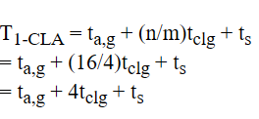
RTL Design
Optimization-1:
Presented by: 1906081
Notes:
For a direct 16-bit CLA implementation: From equation 2.41, we can see the carry equation becomes very complex as the number of bits increases. For bit position 15, we would need:
One 16-input OR gate
15 AND gates with input sizes ranging from 2 to 16 This makes the implementation impractical due to large fan-in requirements.
ta,g = Time to compute generate and propagate signals
tclg = Time for carry lookahead generator (much smaller for 4-bit groups)
ts = Time to compute final sum
The advantages of this approach:
Each CLA block only needs to handle 4 bits, so:
Maximum OR gate input = 5 (vs 16)
Maximum AND gate input = 5 (vs 16)
Reduced complexity and fan-in
Faster tclg due to simpler logic

Slide 12
RTL Design (Insert Genus Pic)
Presented by: 1906081
Notes:
For a direct 16-bit CLA implementation: From equation 2.41, we can see the carry equation becomes very complex as the number of bits increases. For bit position 15, we would need:
One 16-input OR gate
15 AND gates with input sizes ranging from 2 to 16 This makes the implementation impractical due to large fan-in requirements.
ta,g = Time to compute generate and propagate signals
tclg = Time for carry lookahead generator (much smaller for 4-bit groups)
ts = Time to compute final sum
The advantages of this approach:
Each CLA block only needs to handle 4 bits, so:
Maximum OR gate input = 5 (vs 16)
Maximum AND gate input = 5 (vs 16)
Reduced complexity and fan-in
Faster tclg due to simpler logic

Slide 13
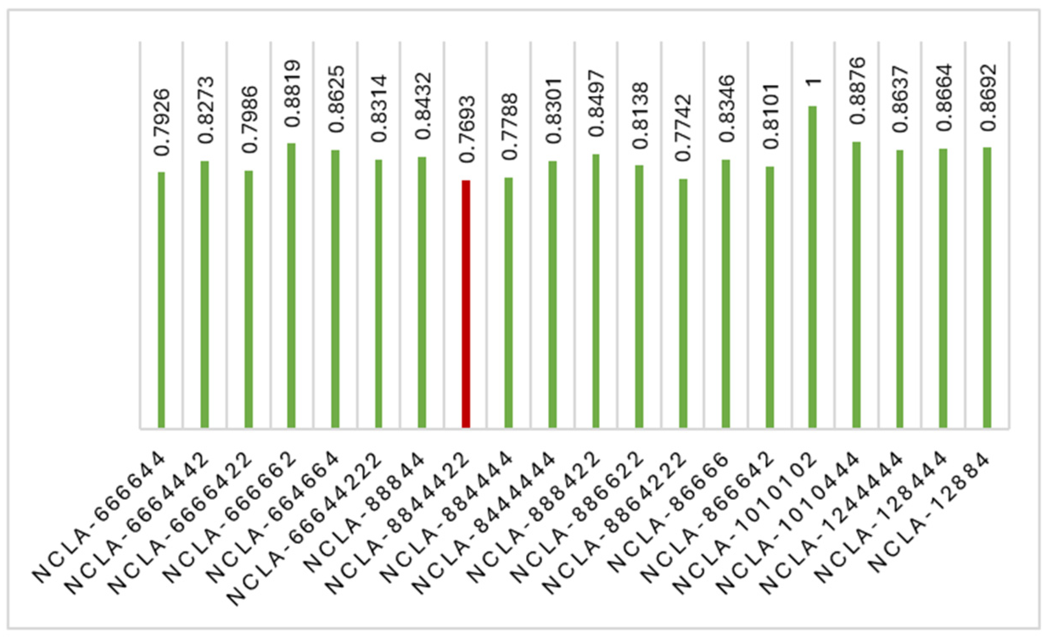
RTL Design (Insert Genus Pic)
Attempted Optimization-1:
[3] P. Balasubramanian and D. L. Maskell, “A New Carry Look-Ahead Adder Architecture Optimized for Speed and Energy,” Electronics, vol. 13, no. 18, pp. 3668–3668, Sep. 2024, doi: https://doi.org/10.3390/electronics13183668.
Presented by: 1906081
Notes:
For a direct 16-bit CLA implementation: From equation 2.41, we can see the carry equation becomes very complex as the number of bits increases. For bit position 15, we would need:
One 16-input OR gate
15 AND gates with input sizes ranging from 2 to 16 This makes the implementation impractical due to large fan-in requirements.
ta,g = Time to compute generate and propagate signals
tclg = Time for carry lookahead generator (much smaller for 4-bit groups)
ts = Time to compute final sum
The advantages of this approach:
Each CLA block only needs to handle 4 bits, so:
Maximum OR gate input = 5 (vs 16)
Maximum AND gate input = 5 (vs 16)
Reduced complexity and fan-in
Faster tclg due to simpler logic

Slide 14
Outline
Summary
PnR with DRC and LVS
Introduction
Directed Testbench
Layered Testbench
Design RTL
Synthesis
Optimization
Final Parameter
Acknowledgement and References
Presented by: 1906081

Slide 15
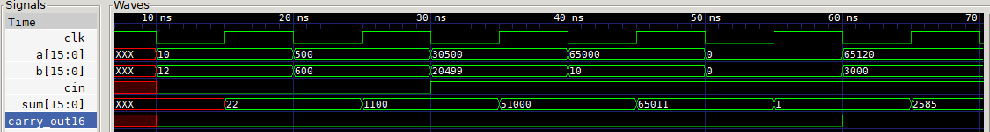
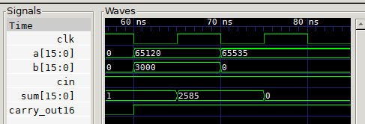
Directed Testbench
Presented by: 1906081

Slide 16
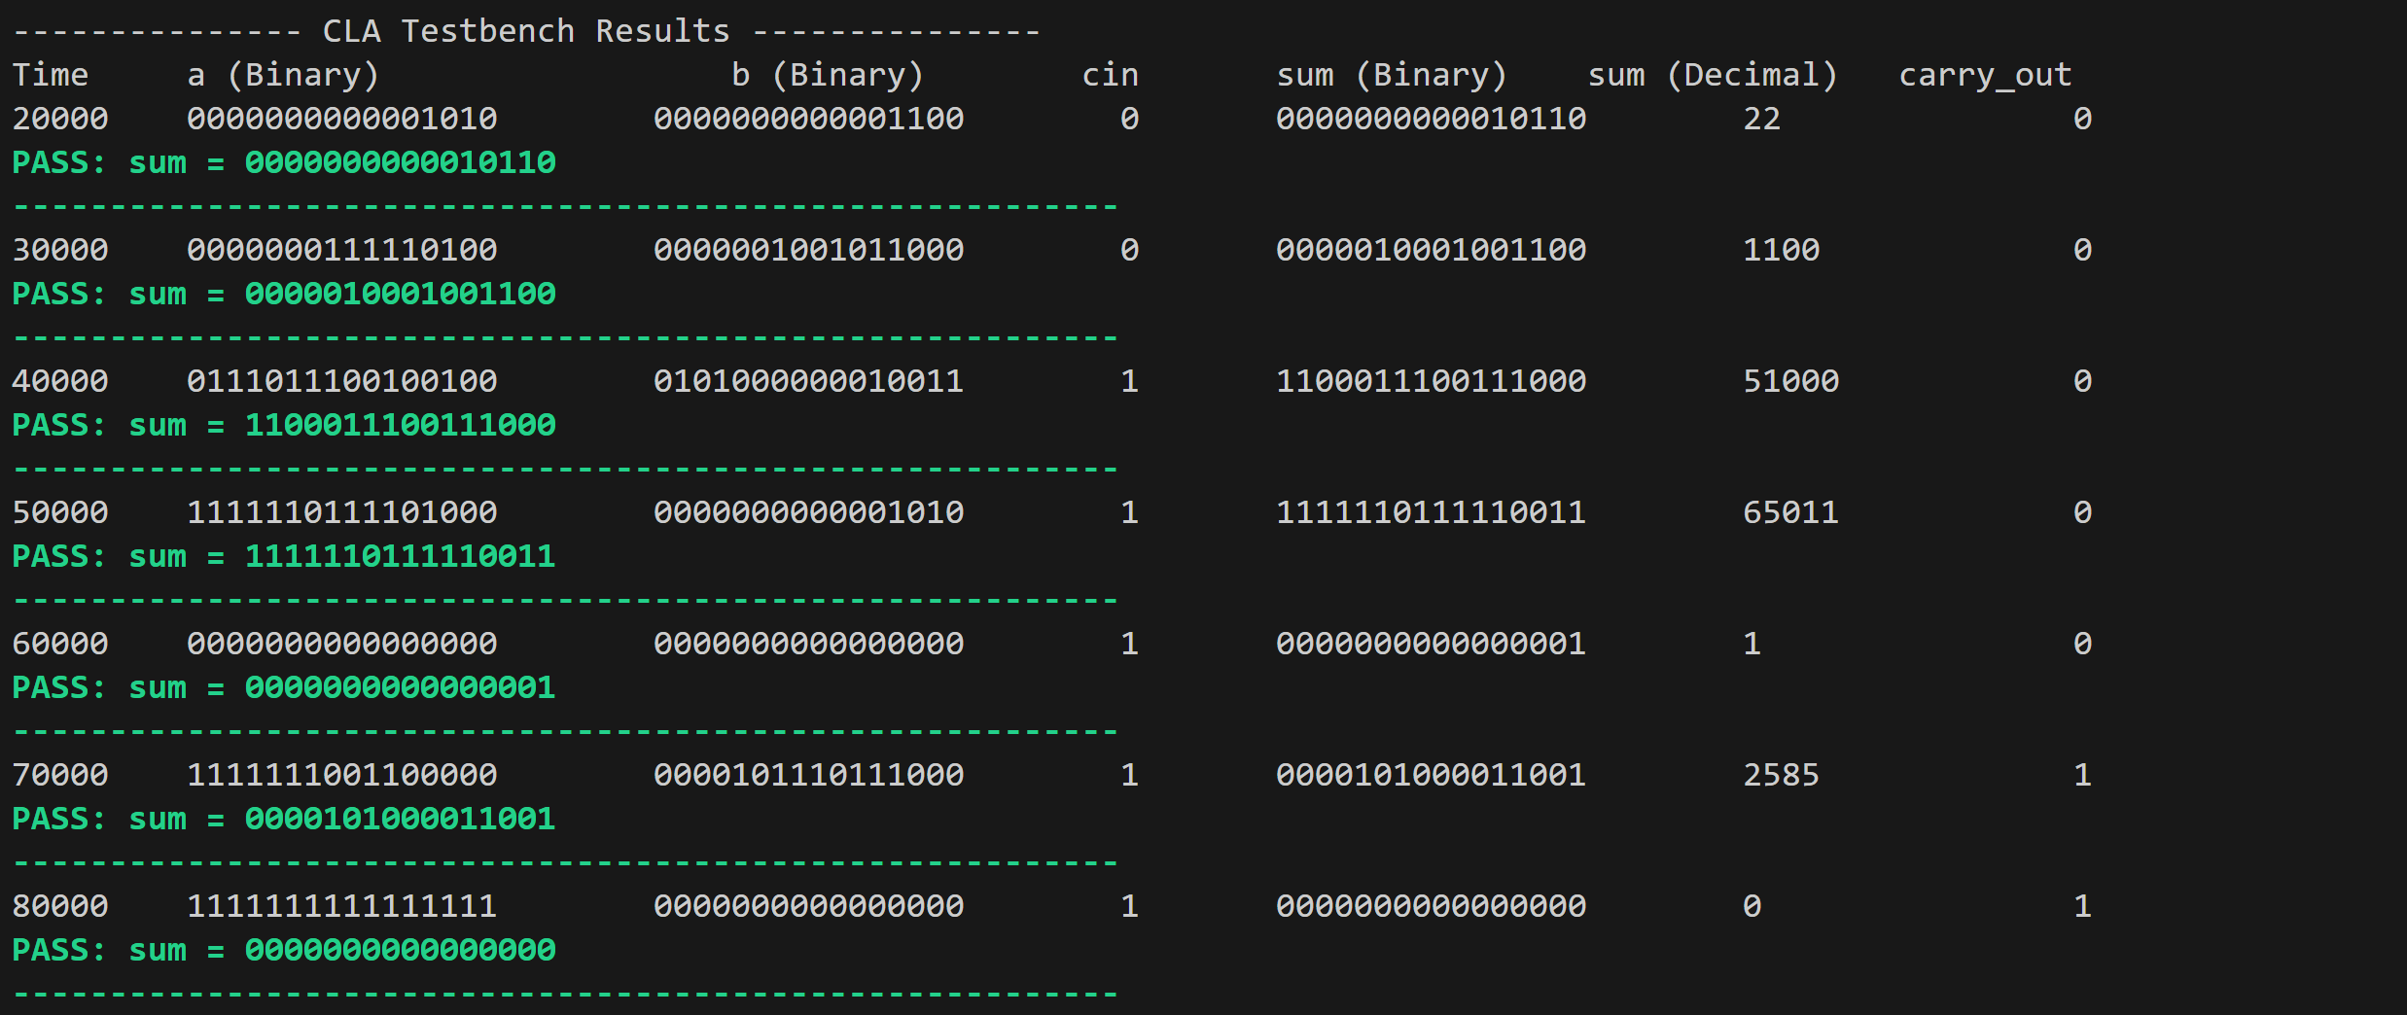
Self Checking Testbench
Presented by: 1906081

Slide 17
Outline
Summary
PnR with DRC and LVS
Introduction
Directed Testbench
Layered Testbench
Design RTL
Synthesis
Optimization
Final Parameter
Acknowledgement and References
Presented by: 1906081

Slide 18
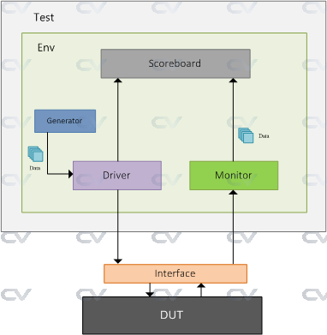
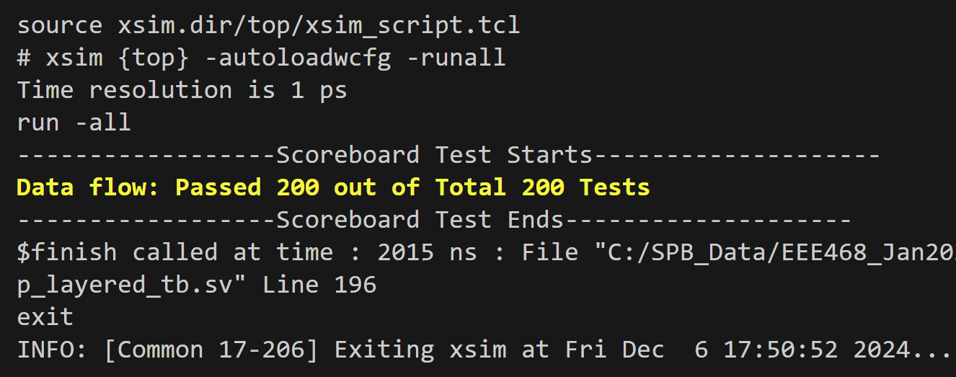
Layered testbench
[4] “SystemVerilog TestBench,” ChipVerify. https://www.chipverify.com/systemverilog/systemverilog-simple-testbench
Presented by: 1906081

Slide 19
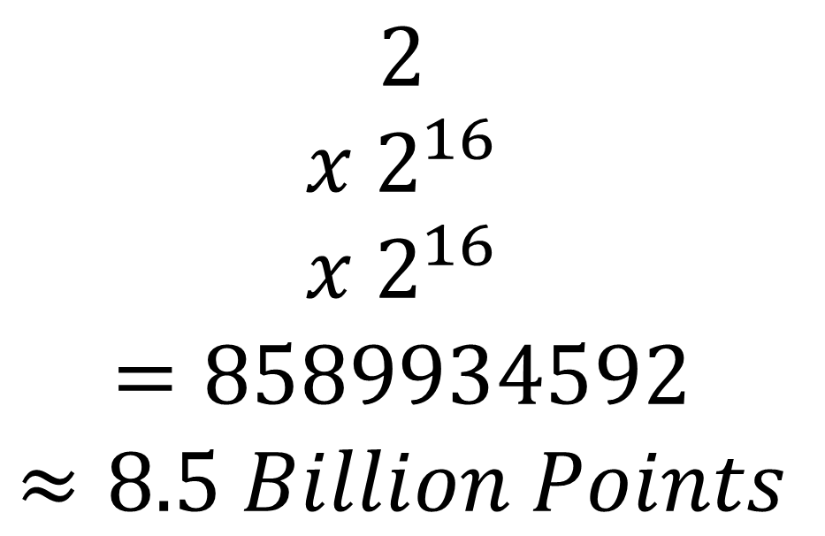
Layered testbench: 3D Space
$$2$$
$$x 2^{16}$$
$$x 2^{16}$$
$$=8589934592$$
$$≈8.5 Billion Points$$
input c
input [15:0] a
input [15:0] b
Presented by: 1906081

Slide 20
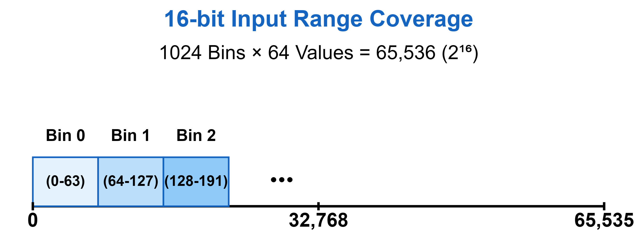

Layered testbench: 3D Space
// Global parameters for bin configuration
parameter int BIN_COUNT = 1024;
parameter int BIN_BITS = $clog2(BIN_COUNT);
// Basic parameters for coverage tracking
localparam int TOTAL_3D_POINTS = 2 * BIN_COUNT * BIN_COUNT;
Presented by: 1906081

Slide 21
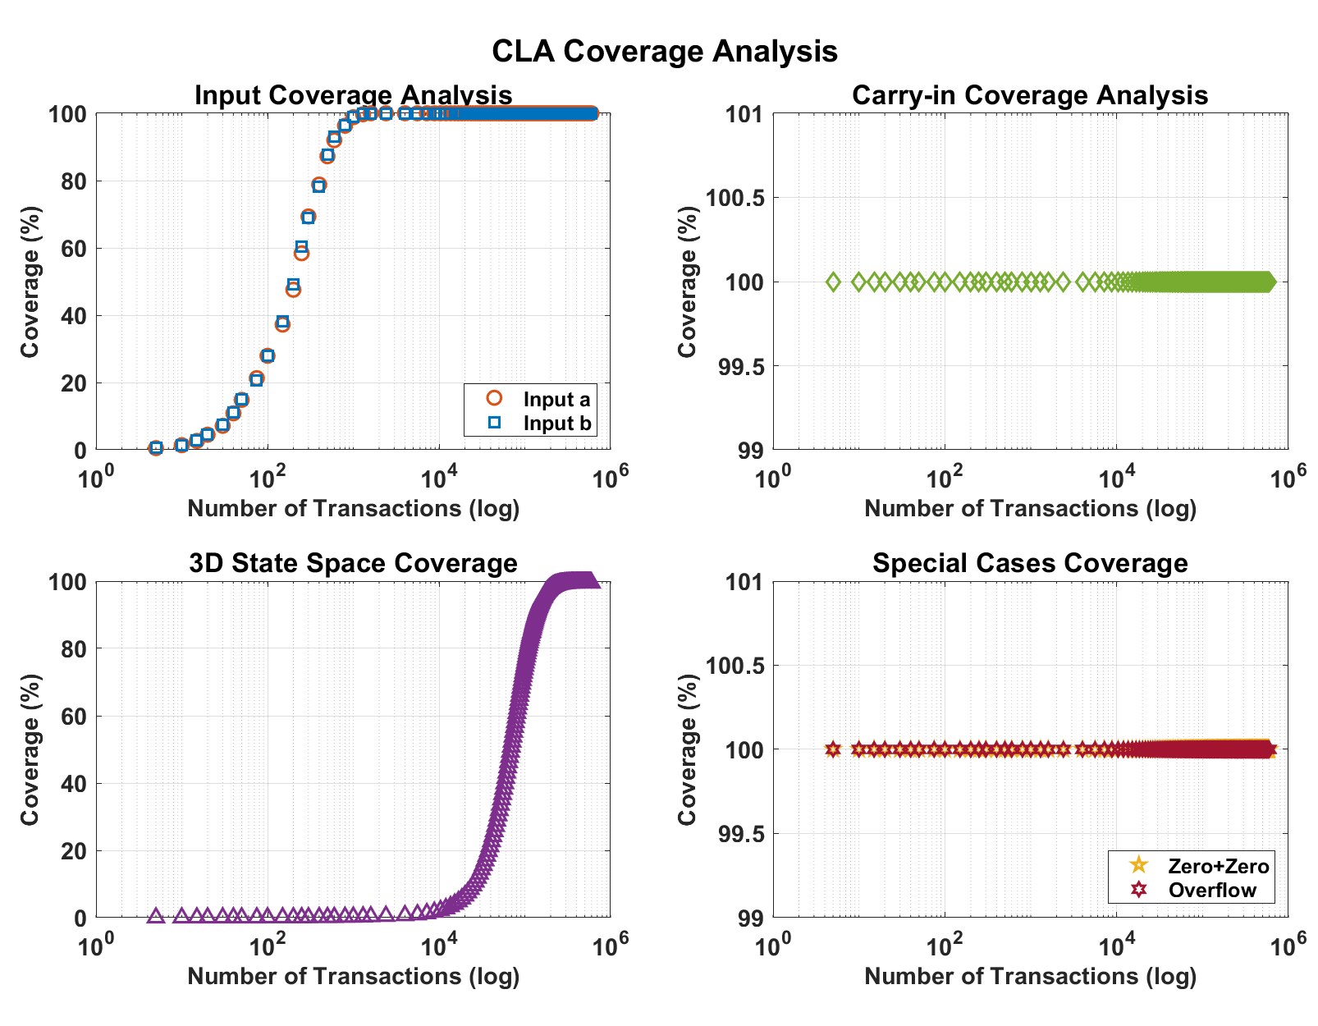
Layered
Testbench: Coverage with Transactions
Rand Function
Up to 240k Transactions
Non-linear Manual Setup
1024 Bins for 16 Bit Input Range
Data Collection in File
All Compare Function
Presented by: 1906081

Slide 22
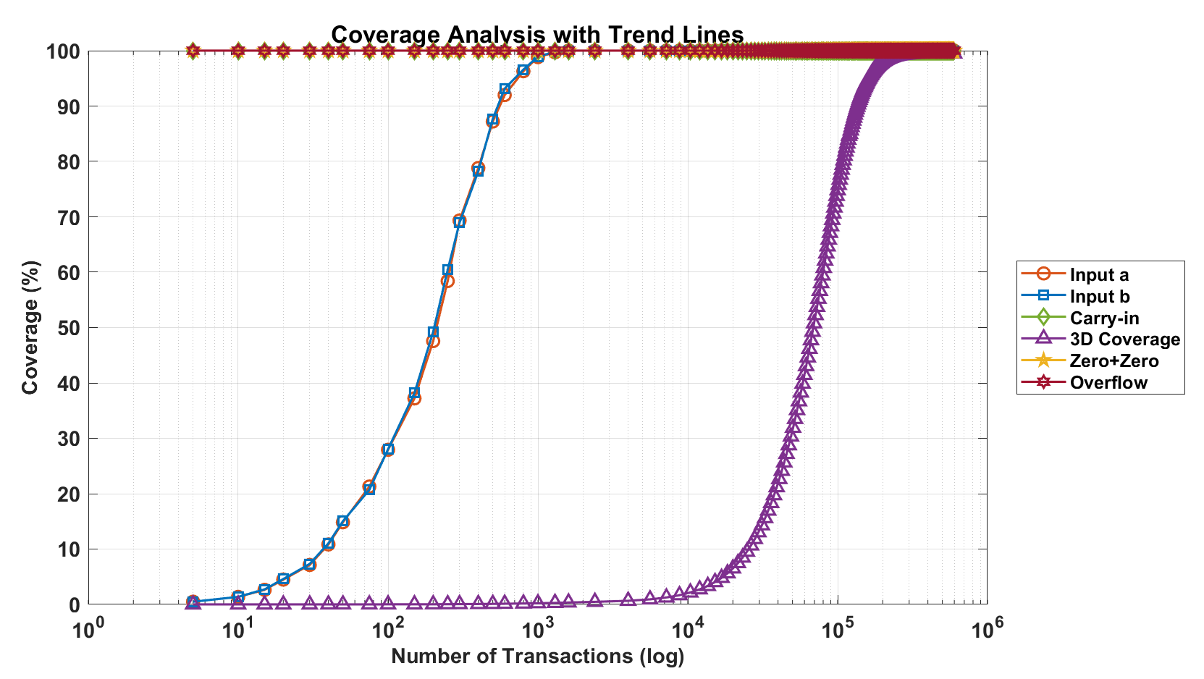
Layered Testbench: Coverage with Transactions
Presented by: 1906081

Slide 23
Outline
Summary
PnR with DRC and LVS
Introduction
Directed Testbench
Layered Testbench
Design RTL
Synthesis
Optimization
Final Parameter
Acknowledgement and References
Presented by: 1906081

Slide 24
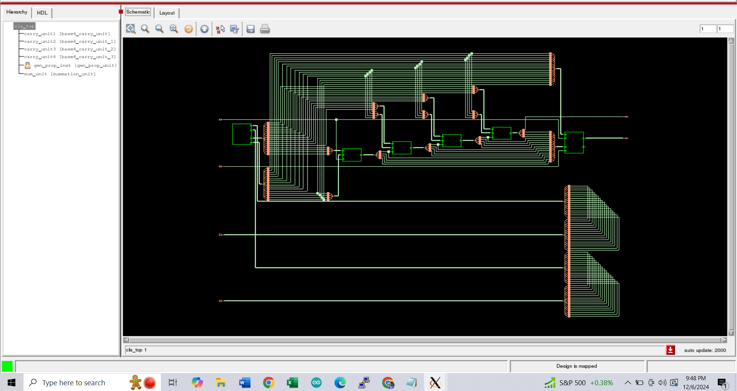
Fig: Schematic of Carry Lookahead Adder
Presented by: 1906174

Slide 25
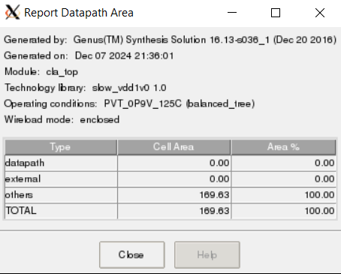
Fig: Report Of Datapath Area
Presented by: 1906174

Slide 26
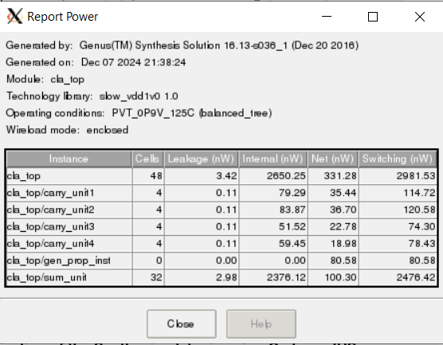
Fig: Power Report
Presented by: 1906174

Slide 27
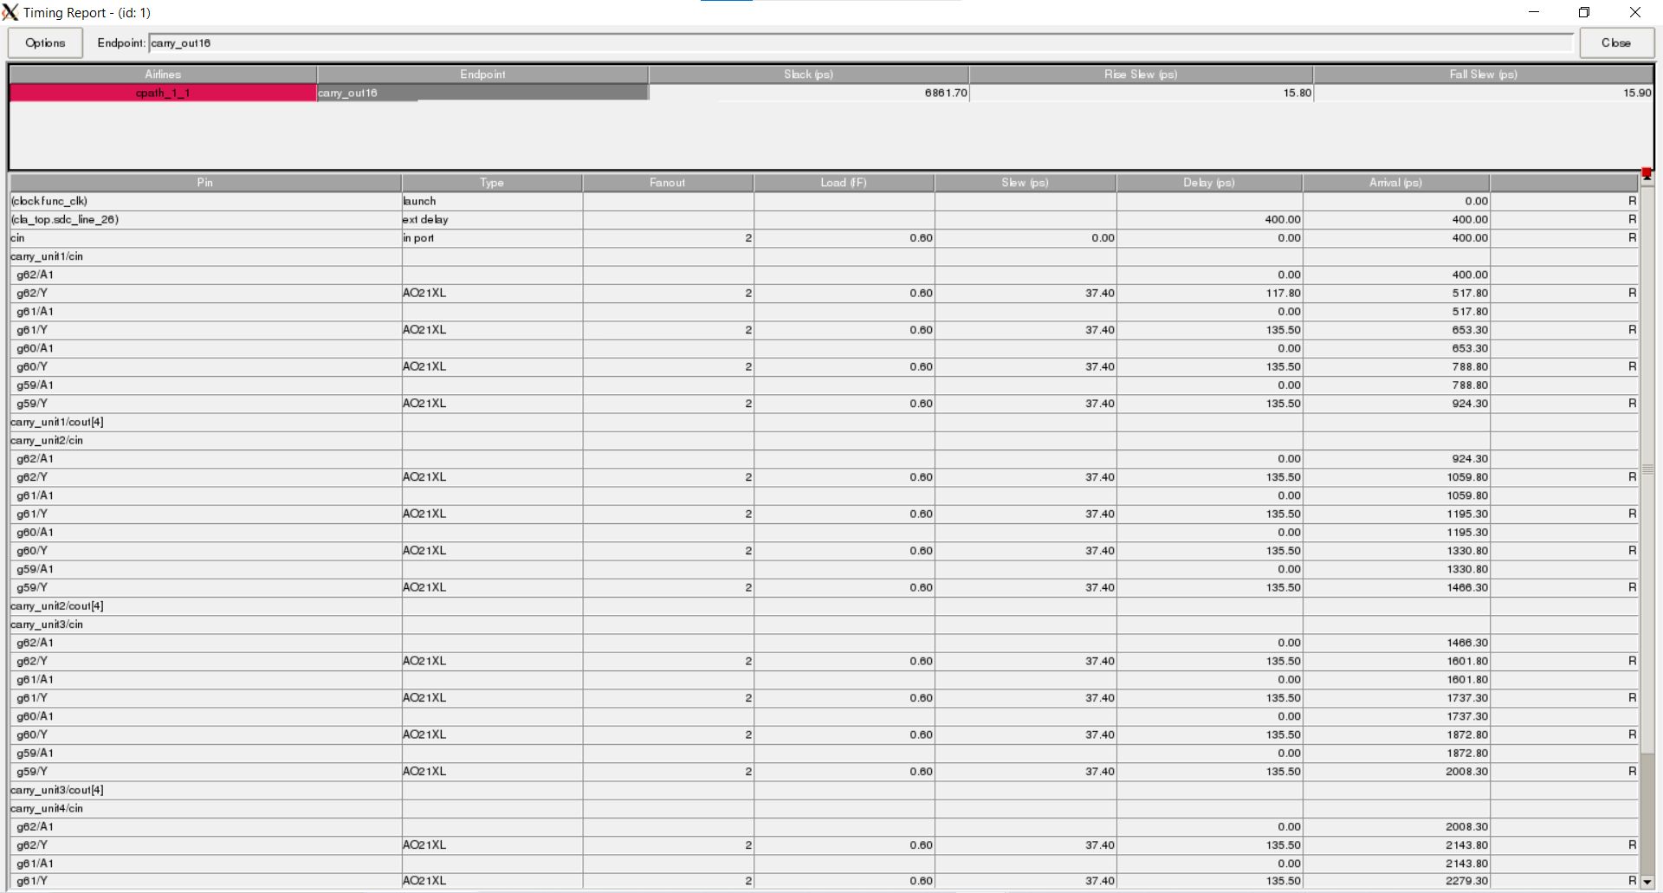
Fig: Timing Analysis
Presented by: 1906174

Slide 28
Outline
Summary
PnR with DRC and LVS
Introduction
Directed Testbench
Layered Testbench
Design RTL
Synthesis
Optimization
Final Parameter
Acknowledgement and References
Presented by: 1906081

Slide 29
Outline
Summary
PnR with DRC and LVS
Introduction
Directed Testbench
Layered Testbench
Design RTL
Synthesis
Optimization Summary
Final Parameter
Acknowledgement and References
Presented by: 1906081

Slide 30
Outline
Summary
PnR with DRC and LVS
Introduction
Directed Testbench
Layered Testbench
Design RTL
Synthesis
Optimization
Final Parameter
Acknowledgement and References
Presented by: 1906081

Slide 31
Outline
Summary
PnR with DRC and LVS
Introduction
Directed Testbench
Layered Testbench
Design RTL
Synthesis
Optimization
Final Parameter
Acknowledgement and References
Presented by: 1906081

Slide 32
Outline
Summary
PnR with DRC and LVS
Introduction
Directed Testbench
Layered Testbench
Design RTL
Synthesis
Optimization
Final Parameter
Acknowledgement and References
Presented by: 1906081

Slide 33
References
Bibliography
[1]
[1] G. B. Rosenberger, “Simultaneous Carry Adder,” Dec. 27, 1960 Accessed: Dec. 06, 2024. [Online]. Available: https://patents.google.com/patent/US2966305
[2] N. H. E. Weste and David Money Harris, CMOS VLSI design : a circuits and systems perspective. Noida: Pearson, 2015.
[3] ErcegovacM. D. and LangT., Digital arithmetic. San Francisco, Ca: Morgan Kaufmann Publishers, 2004.
[4] “SystemVerilog TestBench,” ChipVerify. https://www.chipverify.com/systemverilog/systemverilog-simple-testbench
[5] P. Balasubramanian and D. L. Maskell, “A New Carry Look-Ahead Adder Architecture Optimized for Speed and Energy,” Electronics, vol. 13, no. 18, pp. 3668–3668, Sep. 2024, doi: https://doi.org/10.3390/electronics13183668.
Presented by: 1906081

Slide 34
Summary Slide with All Parameters
Question and Answer Session
Presented by: 1906081

Slide 35
RTL Design (Appendix)
module summation_unit (
input [15:0] p, // Input vector p
input cin, // Carry-in signal
input [16:1] cout, // Carry-out vector for each bit (except for the first bit)
input clk, // Clock signal
output reg [15:0] sum, // Output sum vector
output carry_out16
);
integer i;
always @(posedge clk) begin //changed to posedge for driver and monitor
sum[0] <= p[0] ^ cin; // First bit sum using carry-in
for (i = 1; i < 16; i = i + 1) begin
sum[i] <= p[i] ^ cout[i]; // Remaining bits sum using cout[i]
end
end
assign carry_out16 = cout[16];
endmodule
module gen_prop_unit(
input clk,
input [15:0] a, b,
output [15:0] g, p
);
assign g = a & b; // bitwise generator
assign p = a ^ b; // bitwise propagator
endmodule
module base4_carry_unit(
input [3:0] g, // Generate signals
input [3:0] p, // Propagate signals
input cin, // Carry-in
output [4:1] cout // Carry-out vector
);
assign cout [1] = g[0] | (p[0] & cin);
assign cout [2] = g[1] | (p[1] & cout[1]);
assign cout [3] = g[2] | (p[2] & cout[2]);
assign cout [4] = g[3] | (p[3] & cout[3]);
endmodule
Presented by: 1906081
Notes:
For a direct 16-bit CLA implementation: From equation 2.41, we can see the carry equation becomes very complex as the number of bits increases. For bit position 15, we would need:
One 16-input OR gate
15 AND gates with input sizes ranging from 2 to 16 This makes the implementation impractical due to large fan-in requirements.
ta,g = Time to compute generate and propagate signals
tclg = Time for carry lookahead generator (much smaller for 4-bit groups)
ts = Time to compute final sum
The advantages of this approach:
Each CLA block only needs to handle 4 bits, so:
Maximum OR gate input = 5 (vs 16)
Maximum AND gate input = 5 (vs 16)
Reduced complexity and fan-in
Faster tclg due to simpler logic

Slide 36
RTL Design (Appendix)
// Instantiate the generate and propagate unit for 16 bits
gen_prop_unit gen_prop_inst (
.a(a),
.b(b),
.g(g),
.p(p)
);
// Instantiate the base4 carry unit for the lower 4 bits (a[3:0], b[3:0])
base4_carry_unit carry_unit1 (
.g(g[3:0]),
.p(p[3:0]),
.cin(cin), // The initial carry-in
.cout(cout1) // Carry out for lower 4 bits
);
// Carry-out from the first unit (cout1[4]) becomes the carry-in for the second unit
assign cout_mid1 = cout1[4];
// Instantiate the summation unit to calculate the final 16-bit sum
summation_unit sum_unit (
.p(p), // Propagate signal from the gen_prop_unit
.cin(cin), // Carry-in
.cout({cout4[4:1], cout3[4:1], cout2[4:1], cout1[4:1]}), // Carry-out bits from all carry units
.clk(clk),
.sum(sum), // Output sum
.carry_out16(carry_out16)
);
Presented by: 1906081
Notes:
For a direct 16-bit CLA implementation: From equation 2.41, we can see the carry equation becomes very complex as the number of bits increases. For bit position 15, we would need:
One 16-input OR gate
15 AND gates with input sizes ranging from 2 to 16 This makes the implementation impractical due to large fan-in requirements.
ta,g = Time to compute generate and propagate signals
tclg = Time for carry lookahead generator (much smaller for 4-bit groups)
ts = Time to compute final sum
The advantages of this approach:
Each CLA block only needs to handle 4 bits, so:
Maximum OR gate input = 5 (vs 16)
Maximum AND gate input = 5 (vs 16)
Reduced complexity and fan-in
Faster tclg due to simpler logic

